Slide 1
HỒ MINH KHÔI
25
TEAM 13
TRẦN NGỌC KHÁNH
Demonstration of Cell Division
TRẦN QUỐC KHÁNH
100
TRẦN CÁT KHÁNH
https://www.youtube.com/watch?v=XCg1tfyJsj4
2

Slide 2

INTRODUCTION
The mission of our project is to build an application which visualizes the cell division process of 2 types of cells, Prokaryotic cells and Eukaryotic cells, as well as visualizing components of the cells and their functions.
4

Slide 3
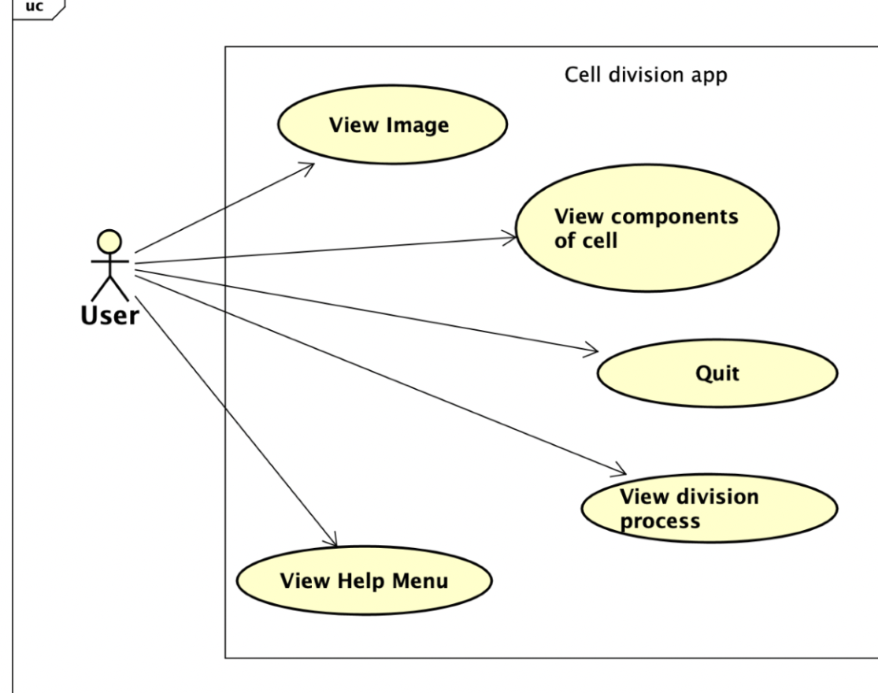
USE CASE DIAGRAM
10
45
70
4

Slide 4
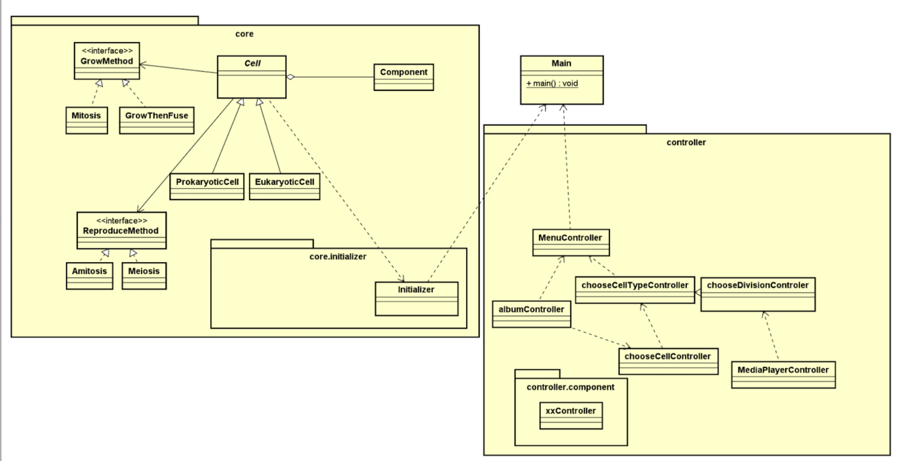
GENERAL CLASS DIAGRAM
3

Slide 5
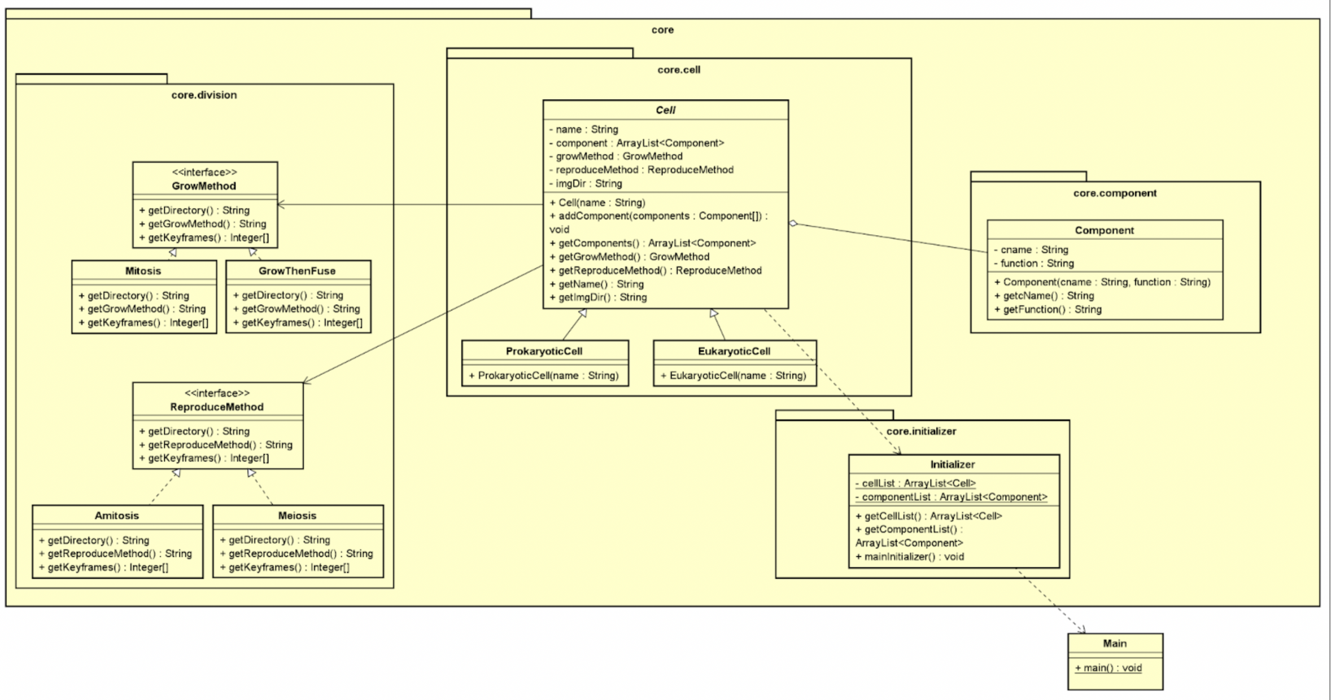


PACKAGE CLASS DIAGRAM
6

Slide 6
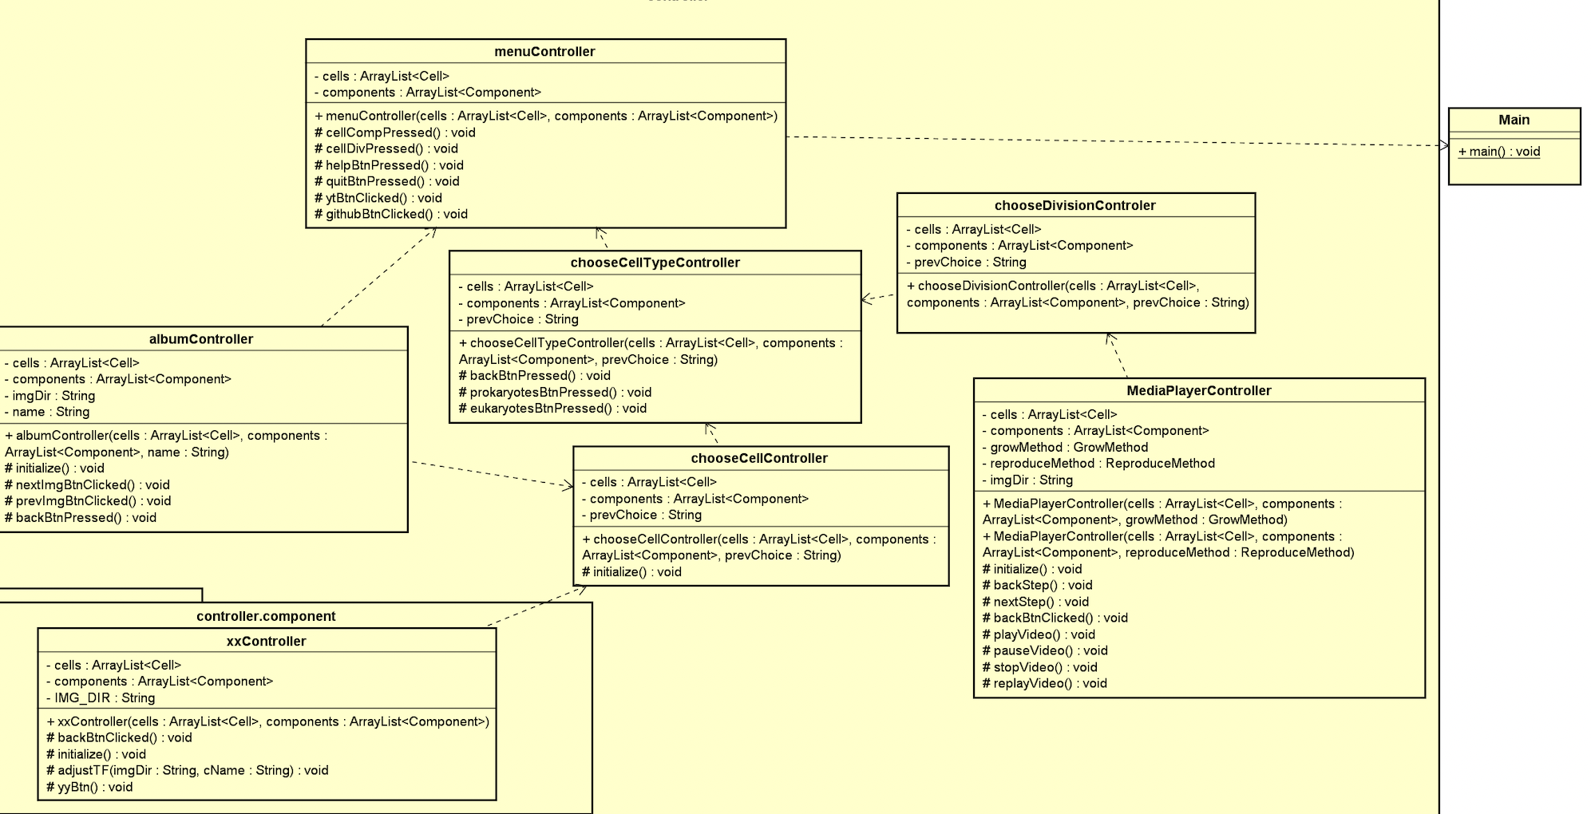
PACKAGE CLASS DIAGRAM

Slide 7

OOP TECHNIQUES
Encapsulation
Major attributes are set private for protecting information from out accessor
For example , private String name , private String imgDir,
Abstraction
abstract class Cell to prevent creating Object instance and optimize method structure
5

Slide 8

OOP TECHNIQUES
Inheritance
Class ProkaryoticCell and Class EukaryoticCell inherit from class Cell
interface: growMethod ,reproduceMethod
==> The main purpose is code reusability. The code that is present in the class Cell can be directly used by the child class
(Class ProkaryoticCell and Class EukaryoticCell)
5

Slide 9
OOP TECHNIQUES
Polymophism
When Amitosis and Meiosis implements reproduceMethod, override the methods getDirectory(),getReproduceMethod(),
getKeyframes()
Similarly , GrowThenFuse and Mitosis implements GrowMethod
==> The main purpose is that polymorphism allows to define one interface and have multiple implementations , Apply upcasting and downcasting flexibly in various usage all over the appication
5

Slide 10
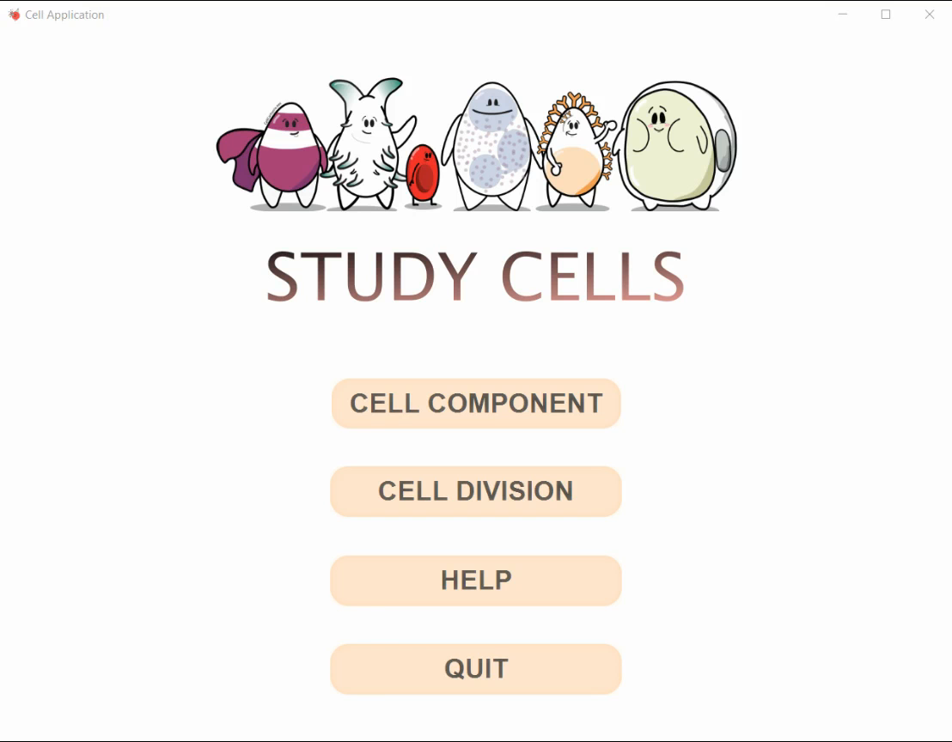
DEMO
https://www.youtube.com/watch?v=XCg1tfyJsj4
4

Slide 11



THANKS FOR LISTENING
khanh.tc204916@sis.hust.edu.vn
15

